Slide 1

Adventures in Node and Nest
ngChina 开发者大会

Slide 2




Principal Architect @
Angular + Web
Founder of ngAtlanta conference
Twitter & Telegram: @zchapple
WeChat: zmanc1987
GitHub: zackarychapple
Linkedin: ZackaryChapple
StackOverflow: users/1749956/zmanc
Notes:
Principal Architect at Ultimate software, basically I go to meetings and watch youtube videos.

Slide 3


Slide 4


SUCCESS

Slide 5


Slide 6


Slide 7
What we will cover
What is Nest
Creating a new Nest based Node server
REST endpoints
Persisting data
File Uploads
Pass Through APIs
Healthchecks
Compression
Validating request objects
Authentication
Role Based Authorization
Field Level Permissions
How to Log
Adding GraphQL
Testing for Scalability
Adding Swagger
Stream Logs with Sockets

Slide 8

What we won’t cover
How Node is better or worse than other server technologies
How to Test or Test Coverage

Slide 9


Slide 10
So what is Nest?

Slide 11


Slide 12


Slide 13


Kamil Mysliwiec @kammysliwiec

Slide 14

NestJS
A progressive Node.js framework for building efficient, reliable and scalable server-side applications.

Slide 15




How I like to think about Nest

Slide 16

Install the CLI

Slide 17
Creating REST endpoints

Slide 18
@Module({
controllers: [UsersController]
})
export class UsersModule {
}
-----------------------------------------------------------------------------------------
@Controller('users')
export class UsersController {}
nest generate module users && nest generate controller users

Slide 19
Controller
@Controller('users')
export class UsersController {
constructor() {
}
@Get('/:username')
getUser(@Param('username') username: string) {
return {};
}
}

Slide 20
@Get('/:username')
getUser(@Param('username')username: string) {
return {};
}
@Get('/:username')
getUser1(@Param('username')username: string, @Res() res: Response) {
res.send({});
}
Both are valid options

Slide 21
@Catch()
@Controller('users')
export class UsersController {
constructor() {
}
@Get('/:username')
getUser(@Param('username')username: string) {
if ('SOME USER CHECK CONDITION') {
return {};
} else {
throw new HttpException({error: 'User Not Found'}, HttpStatus.NOT_FOUND);
}
}
}
Add some error handling

Slide 22
Persisting Data

Slide 23
@Module({
controllers: [UsersController],
providers: [UsersService]
})
export class UsersModule {}
-----------------------------------------------------------------------------------------
@Injectable()
export class UsersService {}
nest generate service users

Slide 24
constructor(private usersService: UsersService) {
}
@Get('/:username')
async getUser(@Param('username')username: string) {
const fetchedUser = await this.usersService.findByUsername(username);
if (fetchedUser) {
return fetchedUser;
} else {
throw new HttpException({error: 'User Not Found'}, HttpStatus.NOT_FOUND);
}
}
Inject the service and begin adding functions

Slide 25


Slide 26



Add “Real” Persistence

Slide 27
@Module({
imports: [
UsersModule,
TypeOrmModule.forRoot({
type: 'mysql',
host: 'localhost',
port: 3306,
username: 'root',
password: 'password',
database: 'ngchina',
entities: [__dirname + '/**/*.entity{.ts,.js}'],
synchronize: true,
})],
controllers: [AppController],
providers: [AppService],
})
export class AppModule {
}
Adding TypeORM to AppModule

Slide 28
@Entity()
export class UsersEntity {
@PrimaryColumn()
username: string;
@ManyToMany(type => RoleEntity, role => role.name, {cascade: ["update"]})
@JoinTable()
roles: Array<RoleEntity>;
}
--------------------------------------------------------------------------------------------------------------------------
@Entity()
export class RoleEntity {
@PrimaryColumn({nullable: false})
name: string;
}
Define our Entities

Slide 29


Slide 30
@Module({
imports: [
TypeOrmModule.forFeature([UsersEntity]),
],
controllers: [
UsersController,
],
providers: [
UsersService,
]
})
export class UsersModule {
}
Add Entity to the Users Module

Slide 31
@Injectable()
export class UsersService {
constructor(
@InjectRepository(UsersEntity)
private readonly userEntity: Repository<UsersEntity>) {
}
async createUser(userDto: CreateUserDto) {
const userEntity = new UsersEntity();
userEntity.username = userDto.username;
const userRoles: Array<RoleEntity> = [];
userDto.roles.forEach((role) => {
const re = new RoleEntity();
re.name = role;
userRoles.push(re);
});
userEntity.roles = userRoles;
await this.userEntity.save(userEntity);
}
findByUsername(username: string) {
return this.userEntity.findOne(username, {relations: ['roles']});
}
}
Begin using the entity to fetch data from MySQL

Slide 32


Slide 33
Validating Request Objects

Slide 34
export class CreateUserDto {
@IsNotEmpty()
username: string;
@IsNotEmpty()
roles: Array<string>;
}
Using DTO

Slide 35
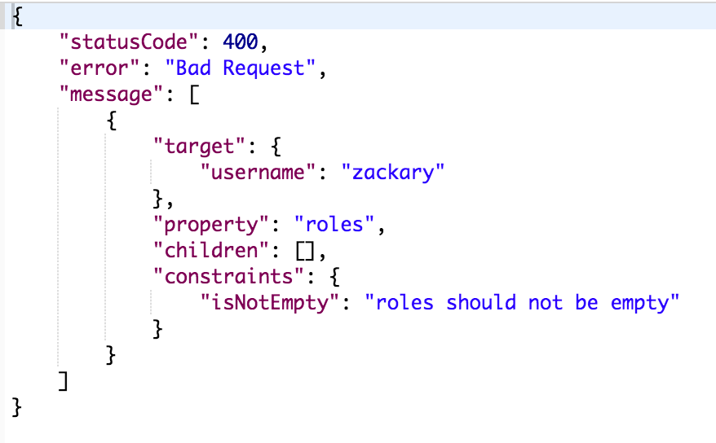
app.useGlobalPipes(new ValidationPipe());
------------------------------------------------------------------------
@Post('/')
async create(@Body() userDto: CreateUserDto) {
await this.usersService.createUser(userDto);
return HttpStatus.OK;
}

Slide 36
@Catch()
@Controller('users')
export class UsersController {
constructor(private usersService: UsersService) {
}
@Get('/:username')
async getUser(@Param('username')username: string) {
const fetchedUser = await this.usersService.findByUsername(username);
if (fetchedUser) {
return fetchedUser;
} else {
throw new HttpException({error: 'User Not Found'}, HttpStatus.NOT_FOUND);
}
}
@Post('/')
async create(@Body() userDto: CreateUserDto) {
await this.usersService.createUser(userDto);
return HttpStatus.OK;
}
}
Finished controller

Slide 37
Field Level Permissions

Slide 38

Is your API oversharing?

Slide 39

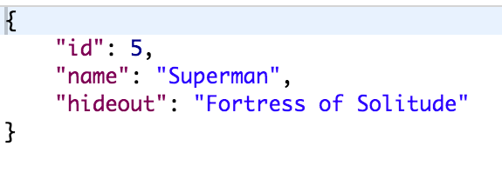

Slide 40


Slide 41
Exclude
&
Expose
import {Exclude, Expose} from 'class-transformer';
@Exclude()
export class Hero {
@Expose()
id: string;
@Expose()
name: string;
@Expose({groups: ['admin']})
hideout: string;
constructor(partial: Partial<Hero>) {
Object.assign(this, partial);
}
}

Slide 42

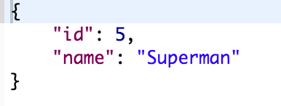

Slide 43
File Uploads

Slide 44
@Controller('file-upload')
export class FileUploadController {
@Post('single')
@UseInterceptors(FileInterceptor('file'))
uploadFile(@UploadedFile() file) {
fs.createWriteStream(path.join(`static_files/${file.originalname}`));
return HttpStatus.ACCEPTED;
}
}
Annotations paying off again

Slide 45
Pass Through APIs

Slide 46


Slide 47
@Catch()
@Controller('file-download')
export class FileDownloadController {
@Get('/passthrough/:x/:y')
downloadPassThrough(@Param('x') x: number, @Param('y') y: number, @Res() res: Response)
{
http.get(`http://placehold.it/${x}x${y}`, (response) => {
if (response.statusCode !== HttpStatus.OK) {
res.status(HttpStatus.NOT_FOUND).json({error: 'Download Not Found'});
} else {
res.status(HttpStatus.OK);
response.pipe(res);
}
});
}
}
Making a request to another server is easy!

Slide 48
Healthchecks

Slide 49
@Get()
healthcheck() {
return {
uptime: process.uptime(),
memory: process.memoryUsage(),
platform: process.platform,
status: HttpStatus.OK,
};
}
Sending basic information on your healthcheck

Slide 50

@Controller('healthcheck')
export class HealthcheckController {
appVersion: string;
constructor() {
const packageJSON: any = JSON.parse(fs.readFileSync('package.json', 'utf-8'));
this.appVersion = packageJSON.version;
}
@Get()
healthcheck() {
return {
appVersion: this.appVersion,
uptime: process.uptime(),
memory: process.memoryUsage(),
platform: process.platform,
status: HttpStatus.OK,
};
}
}
Adding version number is helpful

Slide 51
Compression

Slide 52

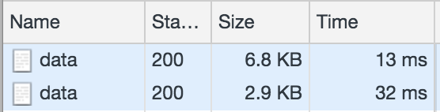
Bandwidth = Performance

Slide 53
app.use(compression());
ONE LINE OF CODE

Slide 54
Authentication

Slide 55
@Module({
imports: [
PassportModule.register({defaultStrategy: 'jwt'}),
JwtModule.register({
secretOrPrivateKey: 'secretKey',
signOptions: {
expiresIn: 3600,
},
}),
UsersModule,
],
controllers: [AuthController],
providers: [AuthService, JwtStrategy],
})
export class AuthModule {
}
Create an Auth Module

Slide 56
@Injectable()
export class AuthService {
constructor(
private readonly usersService: UsersService,
private readonly jwtService: JwtService,
) {}
async signIn(loginDto: LoginDto): Promise<string> {
// In the real-world app you shouldn't expose this method publicly
// instead, return a token once you verify user credentials
const user: JwtPayload = {username: loginDto.username};
return this.jwtService.sign(user);
}
async validateUser(payload: JwtPayload): Promise<any> {
return await this.usersService.findByUsername(payload.username);
}
}
Create your Auth Service

Slide 57
@Injectable()
export class JwtStrategy extends PassportStrategy(Strategy) {
constructor(private readonly authService: AuthService) {
super({
jwtFromRequest: ExtractJwt.fromAuthHeaderAsBearerToken(),
secretOrKey: 'secretKey',
});
}
async validate(payload: JwtPayload) {
const user = await this.authService.validateUser(payload);
if (!user) {
throw new UnauthorizedException();
}
return user;
}
}
Implement Auth Strategy

Slide 58
@Controller('auth')
export class AuthController {
constructor(private authService: AuthService) {
}
@Post('/login')
login(@Body() loginDto: LoginDto, @Req() req: Request) {
return = this.authService.signIn(loginDto);
}
}
Create Auth Controller

Slide 59
@UseGuards(AuthGuard('jwt'))
@Catch()
@UseInterceptors(ClassSerializerInterceptor)
@Controller('heroes')
export class HeroesController {
constructor(private heroesService: HeroesService) {
}
@Get('/')
async getAll(): Promise<Array<Hero>> {
return await this.heroesService.getAllHeroes();
}
}
Guards

Slide 60
Role Based Authorization

Slide 61
@Injectable()
export class RolesGuard implements CanActivate {
constructor(private readonly reflector: Reflector) {}
canActivate(context: ExecutionContext): boolean {
const roles = this.reflector.get<string[]>('roles', context.getHandler());
if (!roles) {
return true;
}
const request = context.switchToHttp().getRequest();
const user = request.user;
const hasRole = () => user.roles.some((role) => {
return !!roles.find((item) => {
return item === role.name;
});
});
return user && user.roles && hasRole();
}
}
Create a role guard

Slide 62
@UseGuards(AuthGuard('jwt'), RolesGuard)
@Controller('heroes')
export class HeroesController {
constructor(private heroesService: HeroesService) {
}
@Roles('admin')
@Delete('/:id')
async delete(@Param('id')id: string) {
const deletedHero = await this.heroesService.deleteHero(id);
if (deletedHero) {
return HttpStatus.NO_CONTENT;
} else {
throw new HttpException({error: 'Nothing to Delete'}, HttpStatus.NOT_FOUND);
}
}
}
Control access at the endpoint level

Slide 63
How to Log

Slide 64

Use The Default Logger
import {Logger} from '@nestjs/common';
Logger.error(`File Not Found: ${file_name}`);

Slide 65
Adding GraphQL

Slide 66
@Module({
imports: [
GraphQLModule.forRoot({
typePaths: ['./**/*.graphql'],
installSubscriptionHandlers: true,
definitions: {
path: join(process.cwd(), 'src/graphql.schema.ts'),
outputAs: 'class',
},
})
})
Add GraphQL to the App

Slide 67
@Module({
providers: [CatsService, CatsResolvers],
})
export class CatsModule {}
Create the Module

Slide 68
@Resolver('Cat')
export class CatsResolvers {
constructor(private readonly catsService: CatsService) {}
@Query()
@UseGuards(CatsGuard)
async getCats() {
return await this.catsService.findAll();
}
@Mutation('createCat')
async create(@Args('createCatInput') args: CreateCatDto): Promise<Cat> {
const createdCat = await this.catsService.create(args);
pubSub.publish('catCreated', { catCreated: createdCat });
return createdCat;
}
@Subscription('catCreated')
catCreated() {
return {
subscribe: () => pubSub.asyncIterator('catCreated'),
};
}
}
Create the Resolvers

Slide 69
@Injectable()
export class CatsService {
private readonly cats: Cat[] = [{ id: 1, name: 'Cat', age: 5 }];
create(cat: Cat): Cat {
this.cats.push(cat);
return cat;
}
findAll(): Cat[] {
return this.cats;
}
findOneById(id: number): Cat {
return this.cats.find(cat => cat.id === id);
}
}
Create the service

Slide 70
type Query {
getCats: [Cat]
cat(id: ID!): Cat
}
type Mutation {
createCat(createCatInput: CreateCatInput): Cat
}
type Subscription {
catCreated: Cat
}
type Cat {
id: Int
name: String
age: Int
}
input CreateCatInput {
name: String
age: Int
}
Create GraphQL Definition

Slide 71
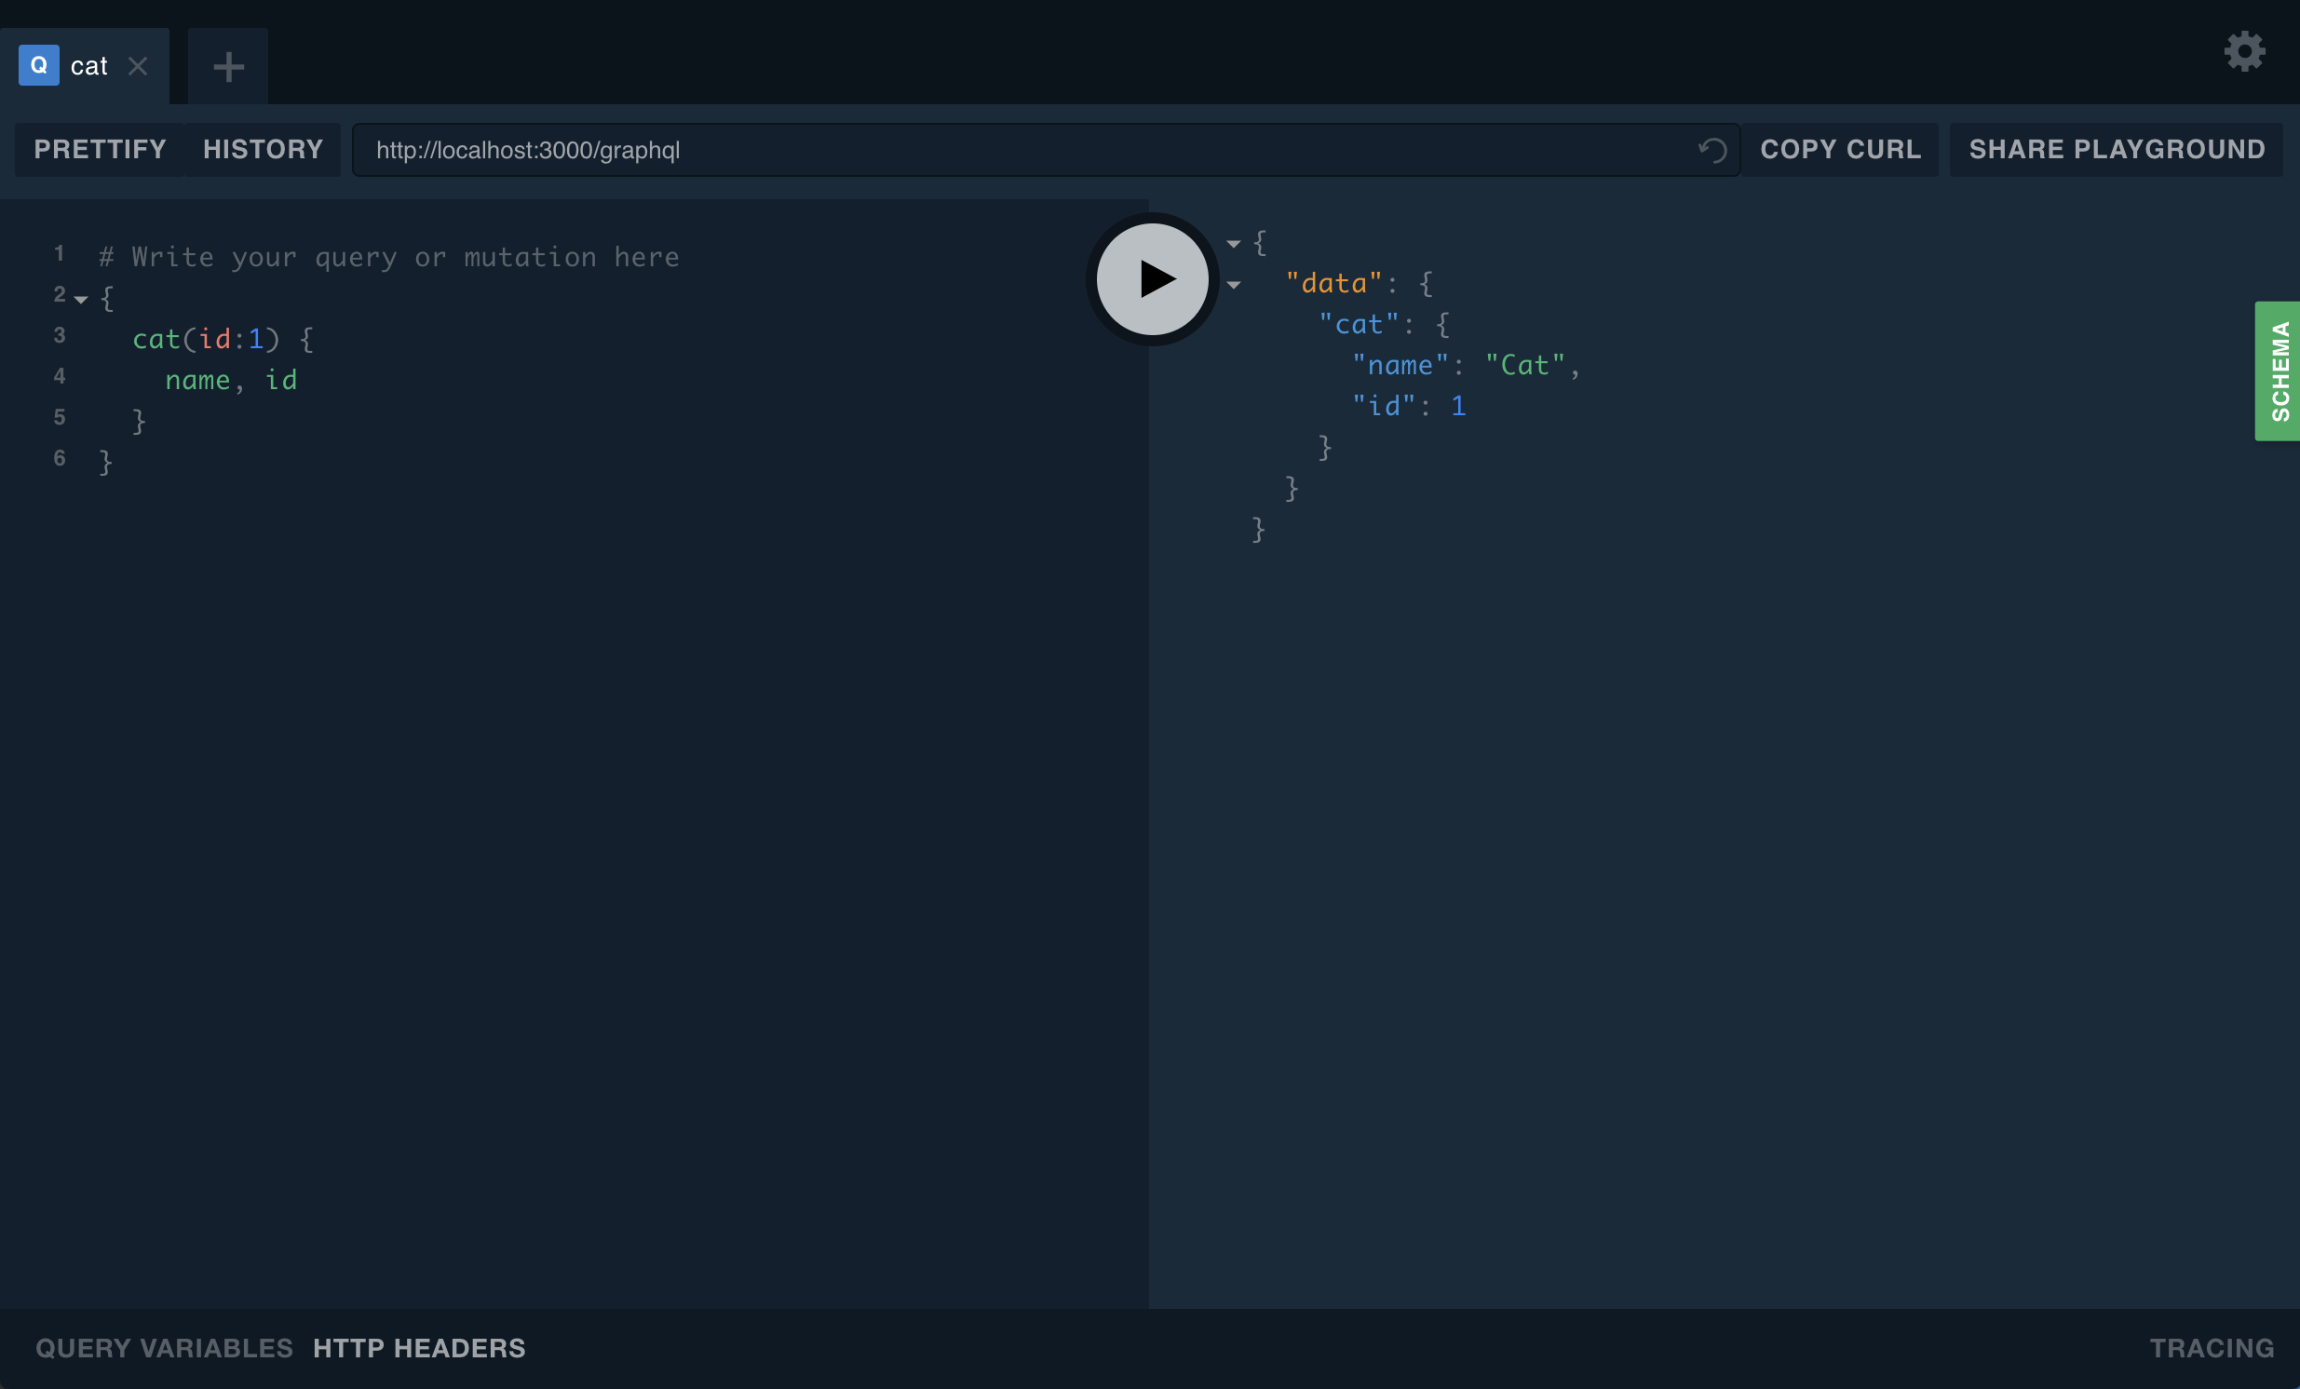

Slide 72
Testing for Scalability

Slide 73

Siege
Siege is an http/https regression testing and benchmarking utility. It was designed to let web developers measure the performance of their code under duress, to see how it will stand up to load on the internet.
https://www.joedog.org/siege-manual/

Slide 74
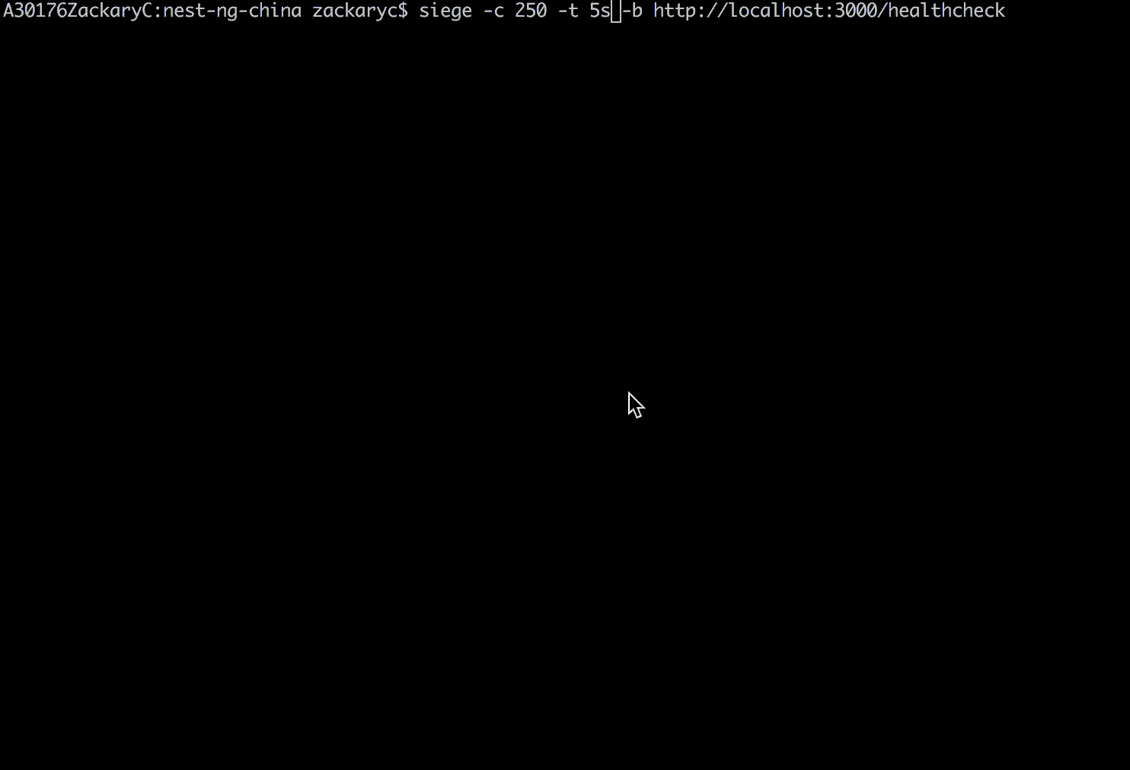
Siege in Action

Slide 75
Swagger

Slide 76
const options = new DocumentBuilder()
.setTitle('nestjs ng china Example')
.setDescription('Demonstrating that Swagger API documentation can be created from nestJS')
.setVersion('1.0') // This should pull from package.json
.build();
const document = SwaggerModule.createDocument(app, options);
SwaggerModule.setup('docs', app, document);
Adding Swagger to your project

Slide 77
@Post('single')
@ApiConsumes('multipart/form-data')
@ApiImplicitFile({name: 'file', required: true, description: 'User Uploaded File'})
@ApiResponse({status: HttpStatus.ACCEPTED, description: 'The File has been saved'})
@ApiOperation({ title: 'Uploads file to the server' })
@UseInterceptors(FileInterceptor('file'))
uploadFile(@UploadedFile() file) {
fs.createWriteStream(path.join(`static_files/${file.originalname}`));
return HttpStatus.ACCEPTED;
}
Annotate your controllers

Slide 78
Sockets

Slide 79


Slide 80
@WebSocketGateway({origins: '*:*'})
export class UiLogsGateway implements OnGatewayConnection, OnGatewayDisconnect {
@WebSocketServer() server;
constructor(private uiLogsService: UiLogsService){
}
handleConnection() {
this.uiLogsService.incrementUser();
Logger.log('Client Connected to Socket');
}
handleDisconnect() {
this.uiLogsService.decrementUser();
Logger.log('Client Disconnected to Socket');
}
@SubscribeMessage('events')
onEvent(client, data: any): WsResponse<any> {
const event = 'events';
Logger.log('Event Received: ' + JSON.stringify(data));
return {event, data};
}
}
Creating a websocket

Slide 81
@Injectable()
export class UiLogsService {
userCount: Observable<number>;
userCountSubject: BehaviorSubject<number> = new BehaviorSubject(0);
constructor() {
this.userCount = this.userCountSubject.asObservable();
}
incrementUser() {
this.userCountSubject.next(this.userCountSubject.value + 1);
}
decrementUser() {
const currentValue = this.userCountSubject.value;
if (currentValue > 0) {
this.userCountSubject.next(this.userCountSubject.value - 1);
}
}
}
Making socket connection stats available via a service

Slide 82


Slide 83
@Controller('healthcheck')
export class HealthcheckController {
appVersion: string;
static currentUserCount: number;
constructor(private uiLogsService: UiLogsService) {
const packageJSON: any = JSON.parse(fs.readFileSync('package.json', 'utf-8'));
this.appVersion = packageJSON.version;
this.uiLogsService.userCount.subscribe((count) => {
HealthcheckController.currentUserCount = count;
Logger.log('updating the count to: ' + count);
});
}
@Get()
healthcheck() {
return {
appVersion: this.appVersion,
uptime: process.uptime(),
memory: process.memoryUsage(),
platform: process.platform,
status: HttpStatus.OK,
currentUserCount: HealthcheckController.currentUserCount,
};
}
}
Now we can see connected user stats via our healthcheck!

Slide 84

谢谢你们

